Slide 1



PASSWORD GENERATOR
Subject: Python for Computational Problem Solving(PCPS)
Subject code: UE23CS151A
MINI PROJECT
SEMESTER I
Under the guidance of,
Divyashree N
Dept of CSE
PES University
TEAM DETAILS
POOJASHREE DH SRN: PES1UG23ME015
TARUN S SRN: PES1UG23EC327
NIKHIL SAMTANI SRN: PES1UG23EC204
SANJANA SHENOY SRN: PES1UG23AM270

Slide 2

INTRODUCTION
IN THIS PRESENTATION, WE WILL DISCUSS PYTHON-BASED PASSWORD GENERATION AND ITS ROLE IN ENHANCING SECURITY. WE WILL EXPLORE THE PRINCIPLES OF SECURE PASSWORD GENERATION AND THE ADVANTAGES OF USING PYTHON FOR THIS
PURPOSE.

Slide 3
TEAM ROLES AND RESPONSIBILITIES
TARUN
AS THE LEAD CODER AND PROGRAMMER, PLAYED A PIVOTAL ROLE IN THE PROJECT. WITH A KEEN UNDERSTANDING OF CODING INTRICACIES AND PROGRAMMING PYTHON, TARUN TOOK CHARGE OF DEVELOPING THE ADVANCED PASSWORD GENERATOR ALGORITHM. HIS LEADERSHIP ENSURED THE IMPLEMENTATION OF A SECURE AND EFFICIENT SYSTEM, CONTRIBUTING SIGNIFICANTLY TO THE PROJECT'S CORE FUNCTIONALITY.
NIKHIL
WITH A FOCUS ON DATA MANAGEMENT AND PRESENTATION SKILLS, TOOK CHARGE OF DRAFTING AND ACCUMULATING THE NECESSARY DATA FOR THE FINAL PRESENTATION. HIS METICULOUS APPROACH TO DATA ORGANISATION AND ANALYSIS CONTRIBUTED TO THE PROJECT'S CREDIBILITY AND PROVIDED A COMPREHENSIVE OVERVIEW OF THE TEAM'S JOURNEY.

Slide 4
SANJANA
SHE PLAYED A PIVOTAL ROLE BY ASSISTING IN CODING DURING THE INITIAL AND FINAL STAGES OF ALGORITHM. HER COLLABORATIVE EFFORTS WERE INSTRUMENTAL IN OVERCOMING CODING CHALLENGES AND ENSURING A COHESIVE AND WELL-EXECUTED IMPLEMENTATION.
POOJASHREE
TOOK LEADERSHIP IN THE INITIAL PHASES OF THE PROJECT BY TAKING THE LEAD IN CRAFTING THE PRESENTATION. HER ABILITY TO COMMUNICATE COMPLEX TECHNICAL DETAILS IN A CLEAR AND ACCESSIBLE MANNER LAID THE FOUNDATION FOR EFFECTIVE TEAM COMMUNICATION.

Slide 5
PROBLEM STATEMENT
OUR AIM IN THIS PROJECT IS TO ENGINEER AN INNOVATIVE PASSWORD GENERATOR SYSTEM THAT SEAMLESSLY INTEGRATES ADVANCED SECURITY FEATURES WITH USER-CENTRIC DESIGN PRINCIPLES.
BY PRIORITIZING BOTH ROBUST PROTECTION AGAINST CONTEMPORARY CYBER THREATS AND USER-FRIENDLY ASPECTS, WE SEEK TO REDEFINE THE LANDSCAPE OF PASSWORD GENERATION
THIS ENDEAVOR PROVIDES INDIVIDUALS WITH A SOPHISTICATED SOLUTION THAT NOT ONLY PRODUCES HIGHLY SECURE PASSWORDS BUT ALSO ALIGNS WITH USER PREFERENCES AND ULTIMATELY ELEVATING THE OVERALL CYBERSECURITY POSTURE

Slide 6
Why should I use a password generator?
The most common way for cybercriminals to hack accounts is guessing the password. They use programs that can try hundreds of passwords per second. Simple, common passwords are breached almost instantly.
When setting up a new account, whether for Facebook, a bank account, an online music service, or anything else, make it safe and protected from intruders. Bank and social media accounts prioritize keeping your private info out of reach from prying eyes. But any site that maintains sensitive information is a target for hacking. There is an average of 2,200 incidents daily, and the U.S. is the most highly targeted country. Fraud cases are up 70% since 2020. Anyone can be a potential victim, and people are paying more attention to how they manage their data
Many of these hackers use brute force attacks to crack the code on your username and password. Reports indicate that successful data breaches were due to weak or stolen passwords the majority of the time. The lesson here is that a stronger password and better security measures would have saved a lot of people a great deal of grief.
Creating a strong password an essential element in safeguarding valuable information and privacy. The difference between a weak password and a strong one can stop an intrusion into your most personal and sensitive accounts and give a hacker free reign with your data.

Slide 7

What Does Password Generator Mean?
A password generator creates random or customized passwords for users. It helps users create strong passwords that provide greater security for a given type of access.
Some password generators are simply random password generators. These programs produce complex/strong passwords with combinations of numbers, uppercase and lowercase letters, and special characters such as braces, asterisks, slashes, etc.
Password generators help those who have to constantly come up with new passwords to ensure authorized access to programs and to manage a large number of passwords for identity and access management. Other kinds of tools include password managers, or “password vaults”, where users manage large numbers of passwords in a secure location.
Password generators are designed not only to eliminate weak, vulnerable passwords, but also to help in complying with password policies and privacy standards.
Password generators are often used with a password management tool to help secure your online accounts.

Slide 8

What Makes a Great Password Generator?
A great password generator:
Creates secure passwords
Allows you to customize complexity and length
Tells you how secure your passwords are
You should use a password generator if:
You are creating passwords for tens or hundreds of accounts
You are using a password manager with a built-in password generator
Security is of paramount concern, and you need 20+ character, complex passwords

Slide 9

The end users of password generators are anyone who wants to create a strong and secure password for their online accounts. This includes individuals, businesses, and organizations that want to protect their sensitive information from unauthorized access. Password generators are also useful for people who have multiple online accounts and want to avoid using the same password for all of them. By using a password generator, users can create unique and complex passwords for each of their accounts, which makes it more difficult for hackers to gain access to their information.

Slide 10
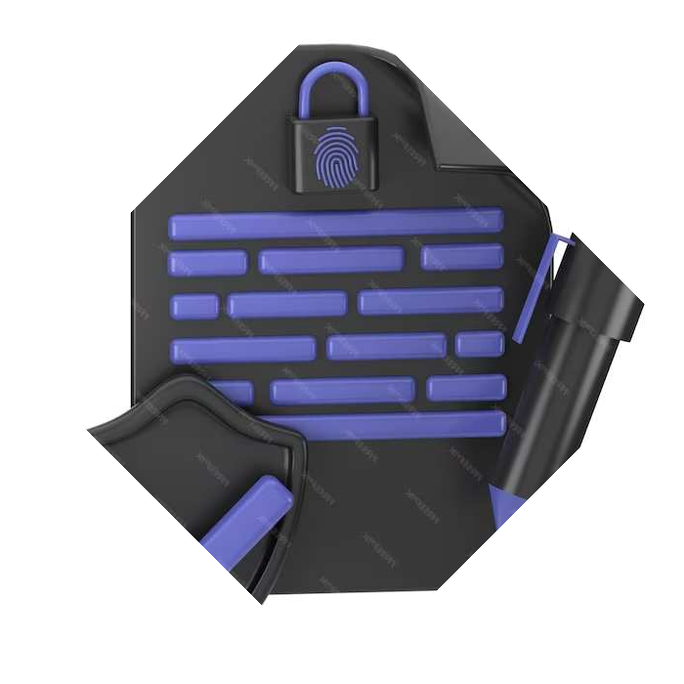
Modules used are: ■ Python’s in-built module ‘random’ – for selecting random sequence of numbers, alphabets or punctuation. Modules used: ♦password_generator ♦strength_assessment – check_strength() ♦improvement_suggestions – suggest_improvements() ♦save_module – save_to_file() ♦clear_module – clear_generated_vars() ♦copy_module ♦username_input_module – get_username() ♦tkinter ♦random ♦string which have functions like generate_password(), assess_strength(), suggest_improvements(password,strength), save_to_file(), copy_to_clipboard() and many more. The program takes user input and generates a password as well as gives suggestions for creating a stronger one.
In this project we have made use of primitive datatypes(strings, integers, Boolean) as well as data structures like lists and tuples.
Multiple usage of iterative and conditional statements.

Slide 11

GUI :- This function is used to create a graphical user inter face for the program .
tkinter :- Tkinter is the standard GUI (Graphical User
Interface) toolkit for Python. It provides a set of tools for
creating graphical user interfaces and is widely used for
developing desktop applications.
Output :- password generated , strength of the password and password
suggestions to improve the password.
Main :- This function is used to call all the functions used
in the program .
Many Functions / Modules used

Slide 12
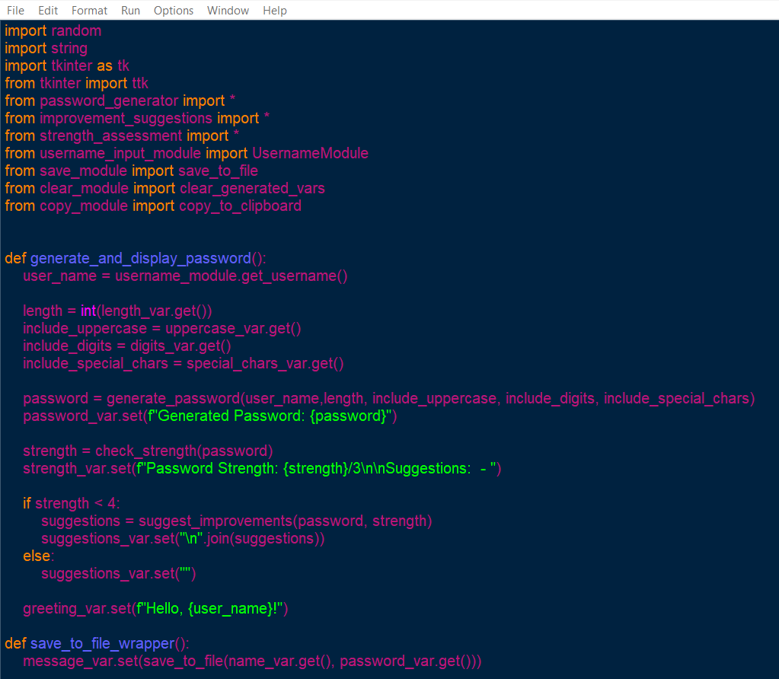
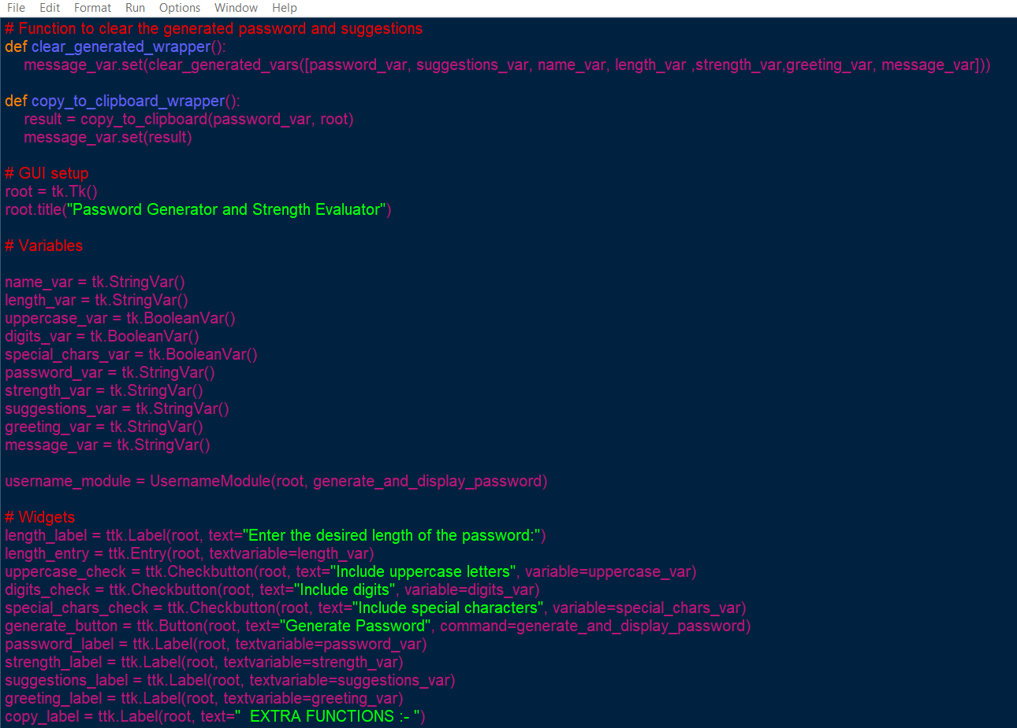
PROGRAM CODE

Slide 13
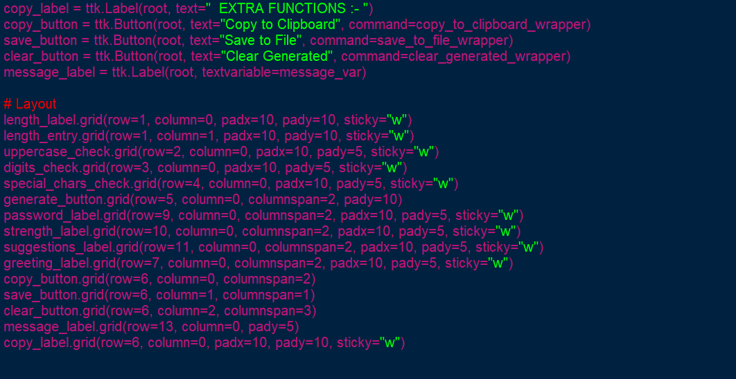
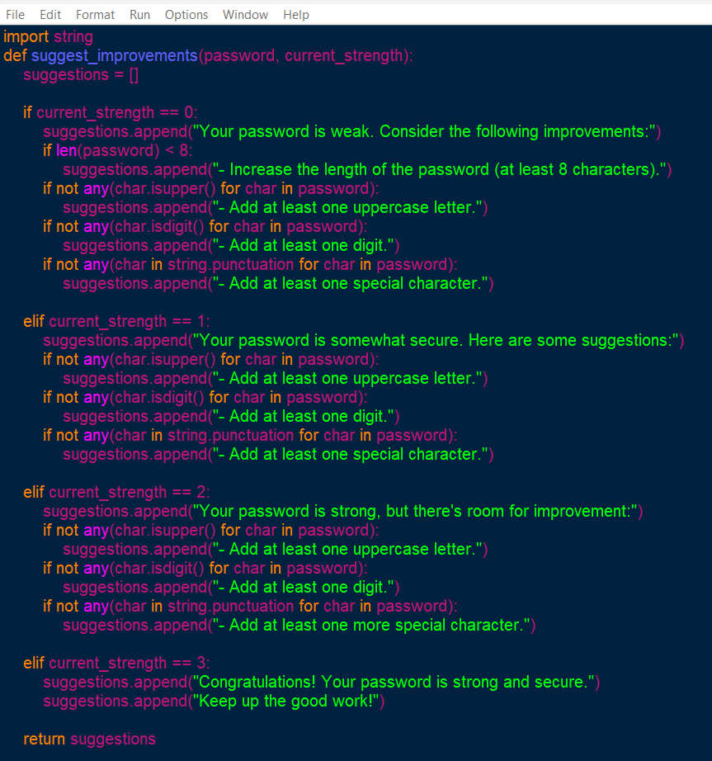
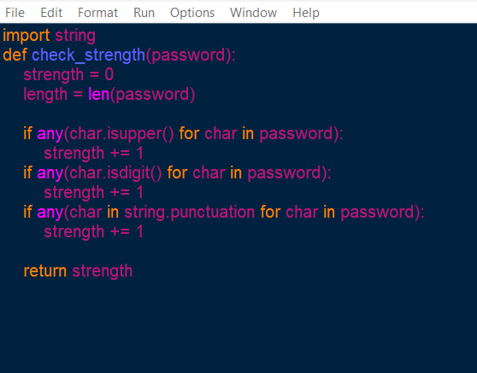

Slide 14
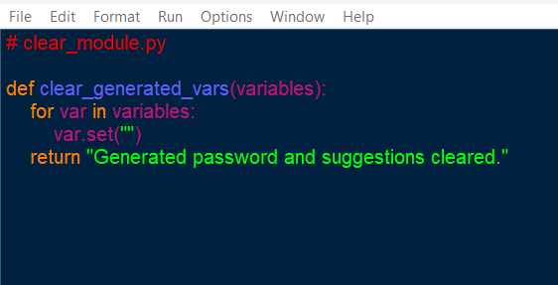
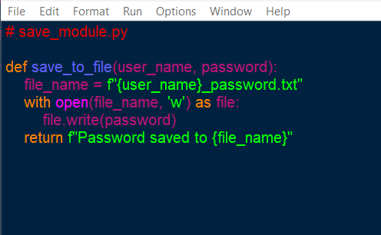
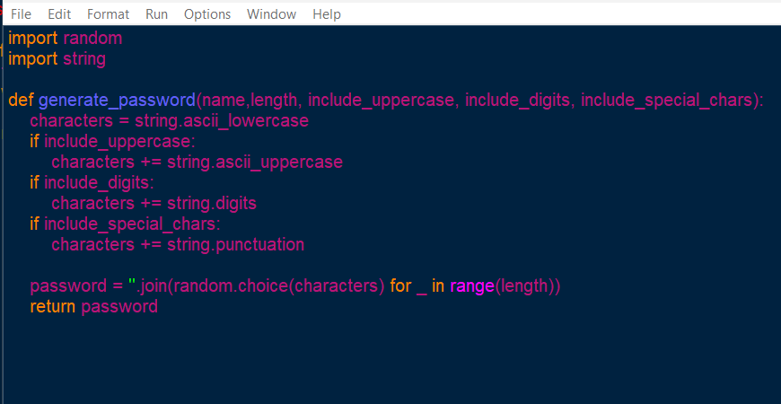
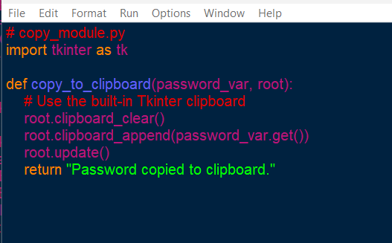

Slide 15
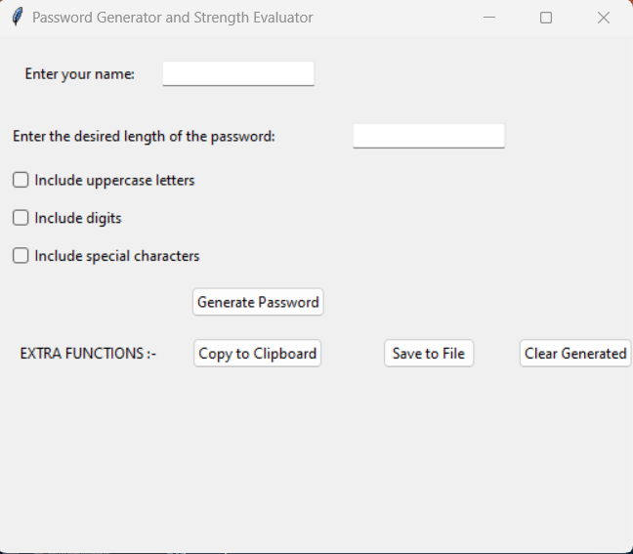
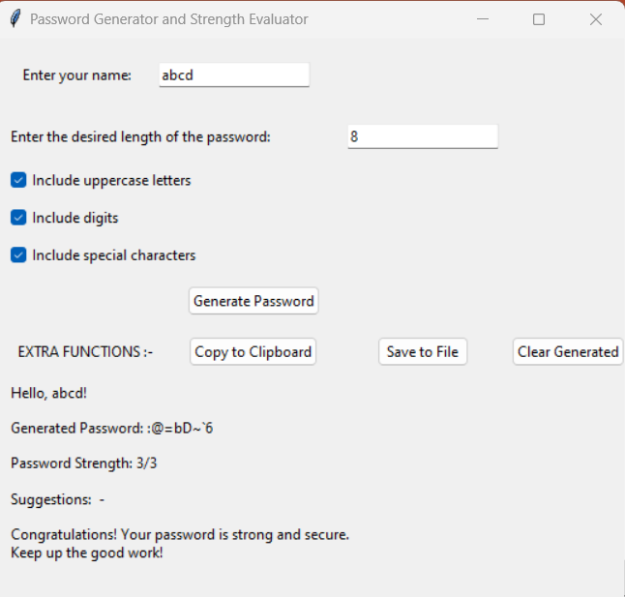
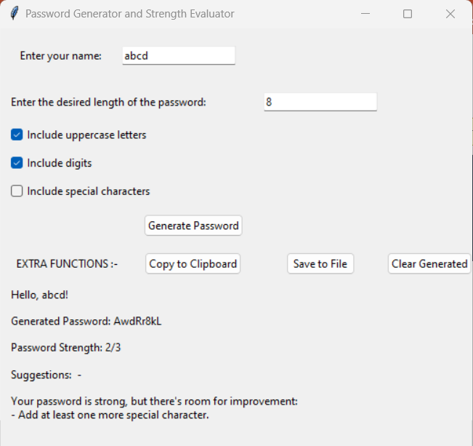
OUTPUT

Slide 16
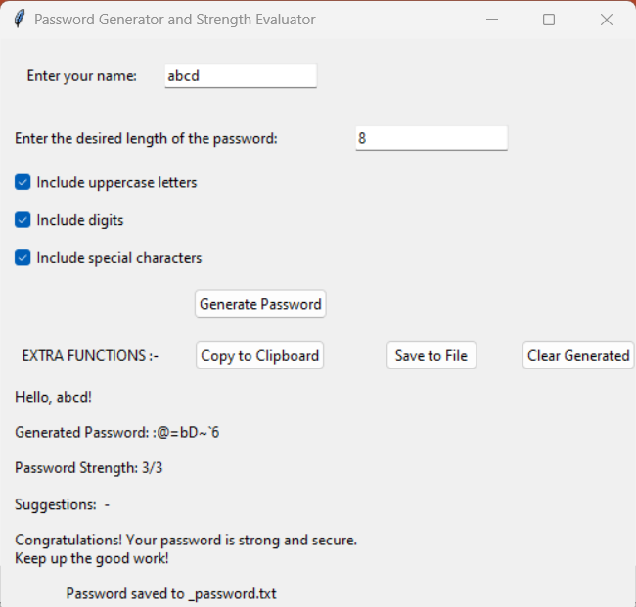
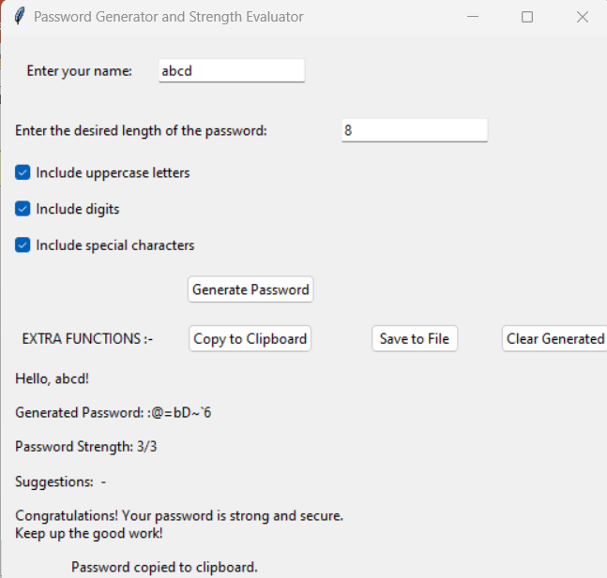
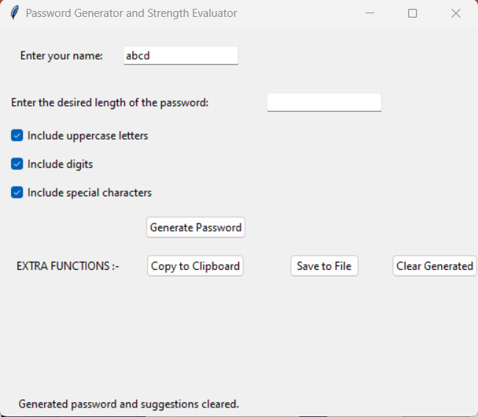

Slide 17

LEARNING FROM THIS PROJECT
Throughout this project, our team underwent significant learning experiences in cybersecurity and software development. Balancing security with user-friendliness, we gained insights into creating robust passwords tailored to user preferences. Collaborative efforts underscored the importance of effective teamwork and communication, highlighting the significance of diverse strengths within the team. Each member's contribution, whether in coding leadership or presentation skills, played a crucial role. This experience enhanced our technical proficiency and emphasized the importance of adaptability and a holistic approach to problem-solving in the realm of password generation and cybersecurity
REFERENCES
Introduction to Python textbook
https://www.codecademy.com
https://www.blackbox.ai
https://www.geeksforgeeks.org

Slide 18
FUTURE WORK
Future developments can be pursued in several directions to enhance its functionality, security, and user experience. Here are some potential avenues for further development:
Integration with Biometrics: Investigate the integration of biometric authentication methods, such as fingerprint or facial recognition.
Machine Learning Integration: Explore the integration of machine learning algorithms to analyze and adapt to evolving cybersecurity threats.
Cross Platform Compatibility: Ensure the password generator is compatible with a wide range of platforms and operating systems, catering to the diverse needs of users across different devices.

Slide 19

CONCLUSION
In conclusion, Python-based password generation plays a pivotal role in enhancing security by providing robust and reliable methods for creating secure passwords.
Embracing Python's capabilities is essential for safeguarding sensitive information

Slide 20



THANKS!

